Slide 1
Radio Frequency Signal Generator
By: Ethan Cura, Abel Gonzalez, Joseph Hinz and James Taylor
Notes:
James

Slide 2
Purpose
The goal of this project is to supplement the existing market with a low-cost RF signal generator for students and enthusiasts.
Notes:
James

Slide 3
Technical Summary
The signal generator shall have a frequency range between 1 and 500MHz with 1Hz precision.
The signal generator shall be able to frequency and amplitude modulate this carrier frequency.
The signal generator shall minimize any spurious signals for a spectrally pure output.
Notes:
Abel

Slide 4
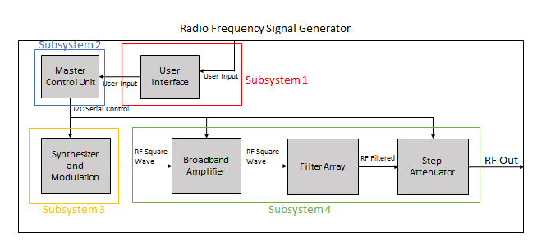
System Overview
Subsystem 1: Ethan Cura
Subsystem 2: Abel Gonzalez
Subsystem 3: Joseph Hinz
Subsystem 4: James Taylor
Notes:
Ethan

Slide 5
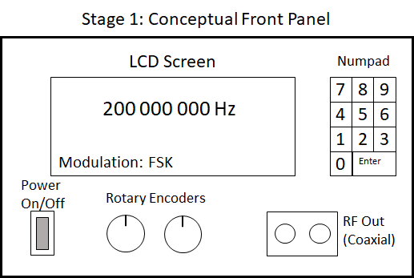
Subsystem 1: User Interface

Slide 6
Subsystem 1: Deliverables
Design functional UI that allows users to effectively communicate with the MCU
Design PCB to integrate all UI elements
Allow PCB to integrate with MCU to allow for communication with UI element and eventually other I2C components
Allow for PCB to supply power to UI elements and eventually the other PCB’s within the project
Notes:
UI consits of LCC+D screen,rotary encoder,zmcu,power suppl and numpad

Slide 7
Subsystem 1: Challenges
Learning PCB design principles
Finding the proper parts that satisfy PCB layout specifications

Slide 8
Subsystem 1: Validation Plan
Validation correct PCB design
Verify that MCU, UI components, and Power supply can be integrated into the PCB
Validate UI components will function as expected when given control signals

Slide 9
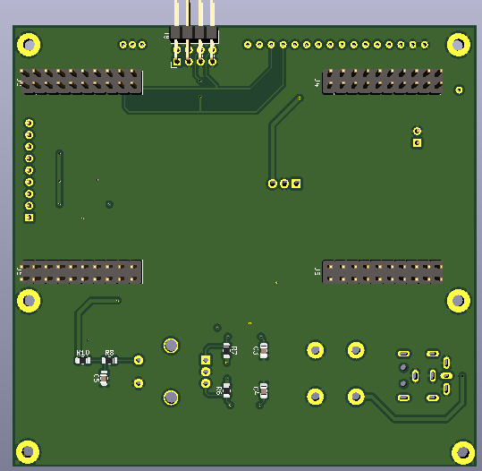
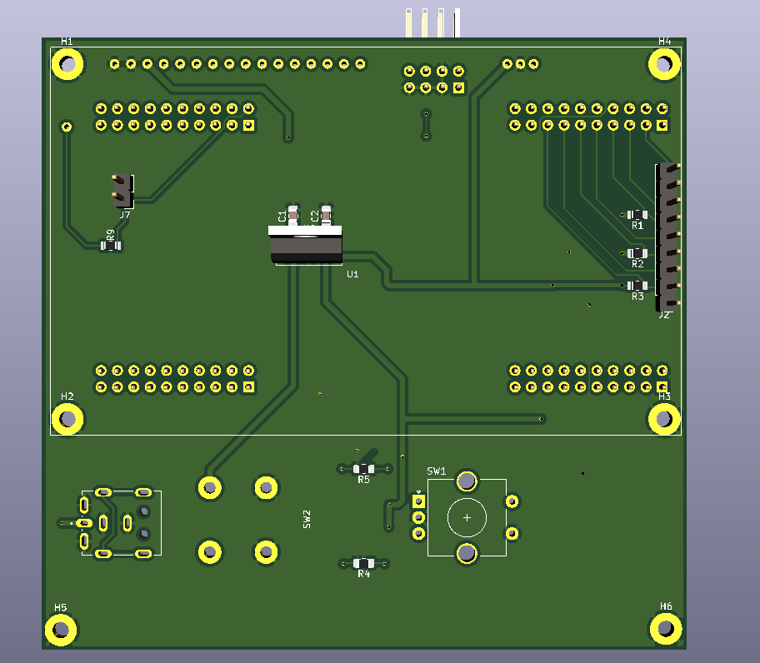








Validation Plan
Notes:
UI consits of LCC+D screen,rotary encoder,zmcu,power suppl and numpad

Slide 10
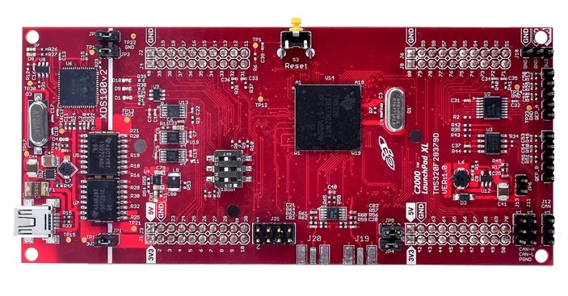
Subsystem 2: Master Control Unit
Notes:
Controls the synthesizer, modulation, filter selection, and appropriate attenuation
Abel

Slide 11
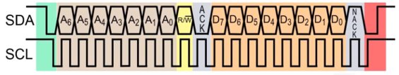
Subsystem 2: Deliverables
Utilize I2C Communication
User Interface Setup

Slide 12
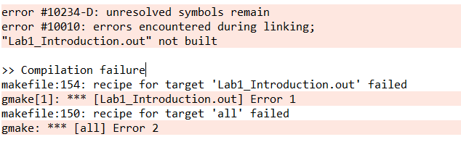
Subsystem 2: Challenges
Learning Code Composer Studio
Linkage Errors

Slide 13
Subsystem 2: Validation Results
Debugging MCP23008
I2C Expander
Smoother Integration for other Subsystems
Finalizing Rotary Encoder User Interface
Notes:
Include screenshots

Slide 14
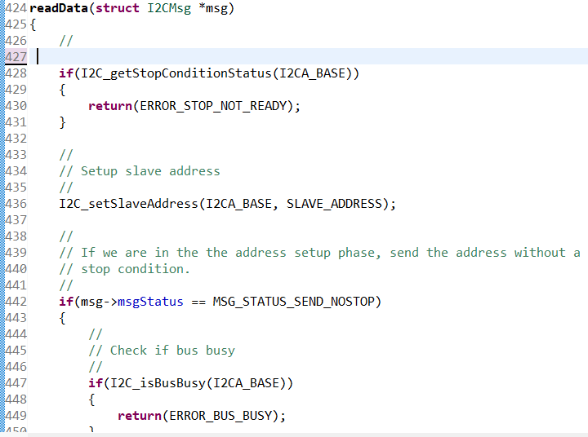
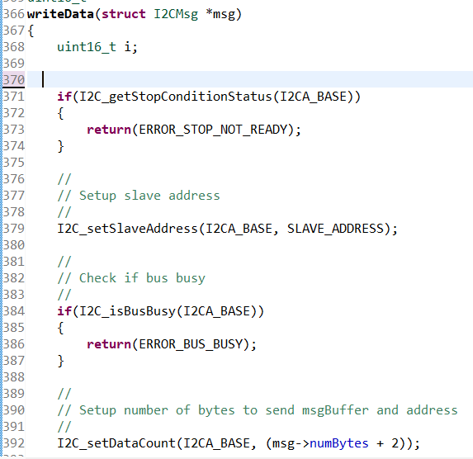
Subsystem 2: Screenshots

Slide 15
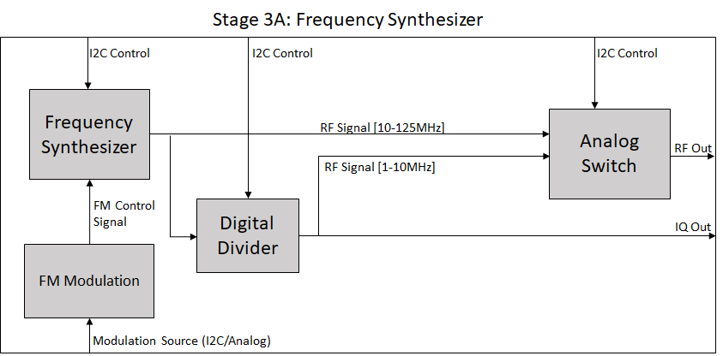
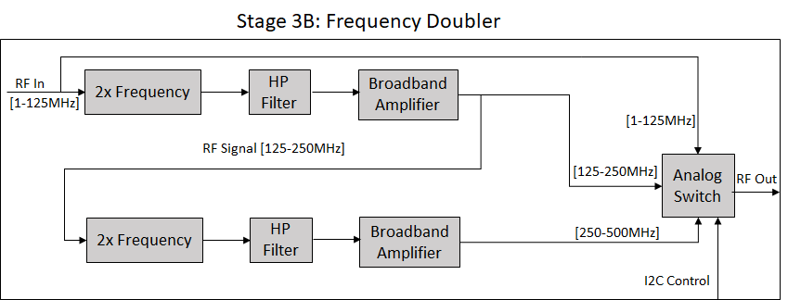
Subsystem 3: Synthesizer and Modulation
Notes:
Joe

Slide 16
Subsystem 3: Deliverables
Output square wave between 1 and 500MHz
Output will have 1Hz precision
Output will be controlled by I2C communication from an MCU
Output can be modulated using FSK and ASK.

Slide 17
Subsystem 3: Challenges
Accounting for frequency dependence on all components on the signal path.
Many components for high frequencies are very small and hard to solder.
Ordering PCB's takes time and close attention to detail.

Slide 18
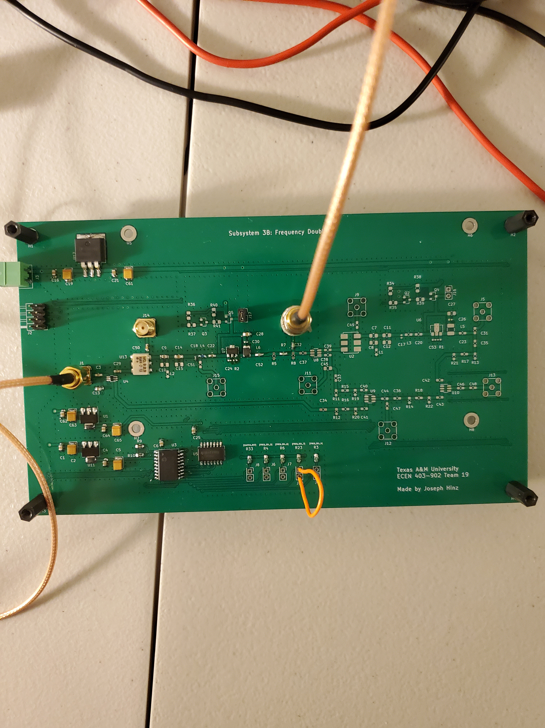
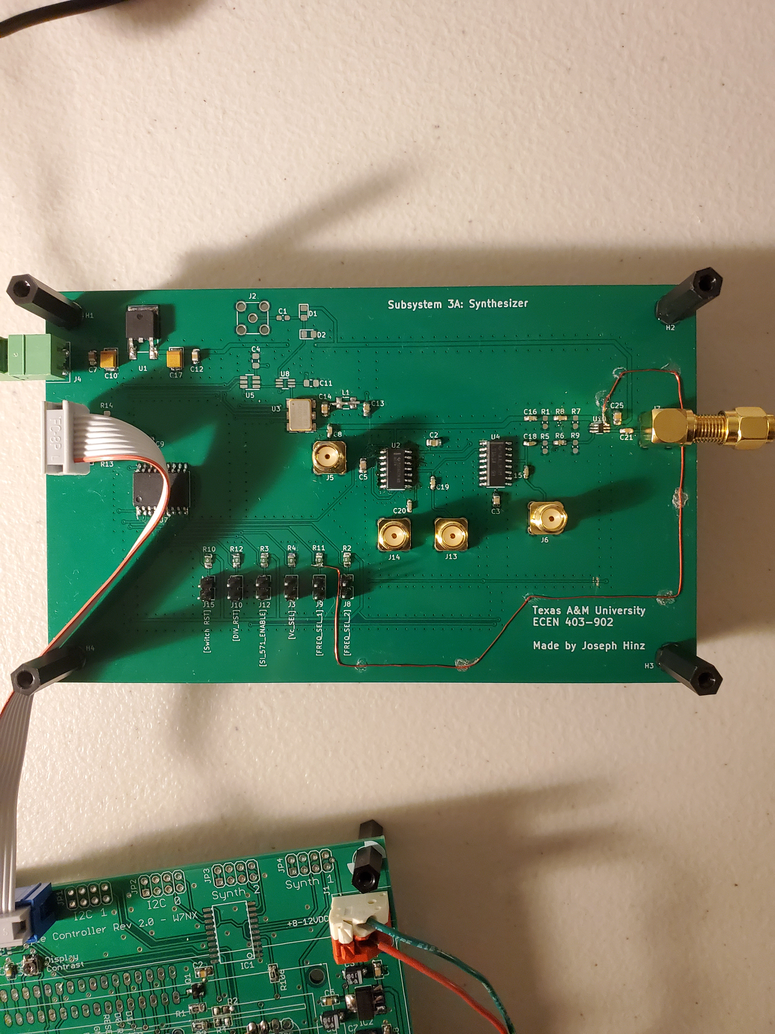
Subsystem 3: Picture

Slide 19
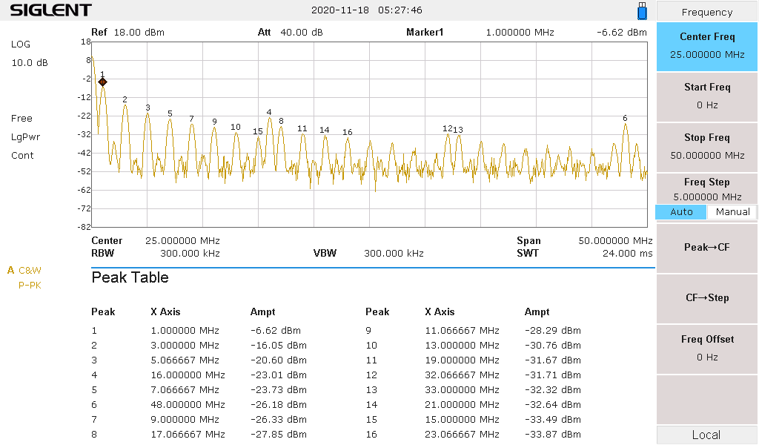
Subsystem 3: Validation Results – Frequency Range

Slide 20
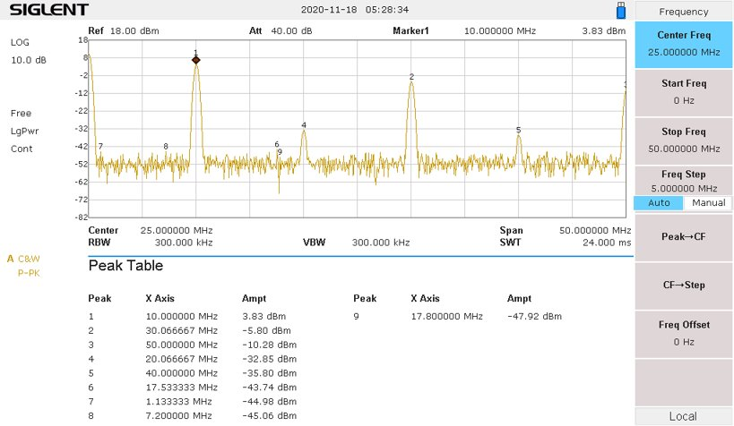
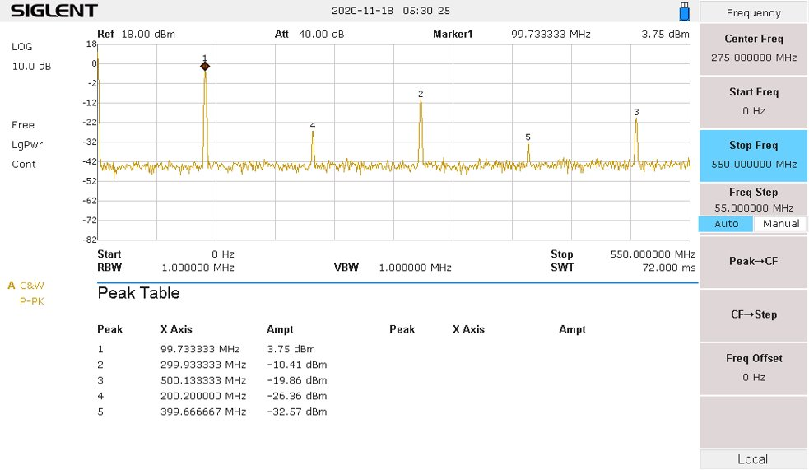
Subsystem 3: Validation Results – Frequency Range

Slide 21
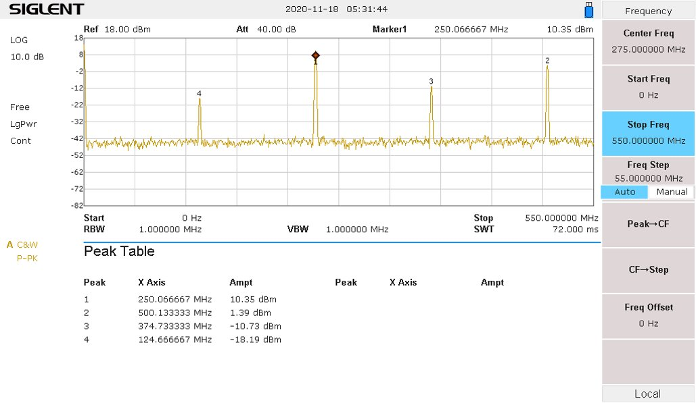
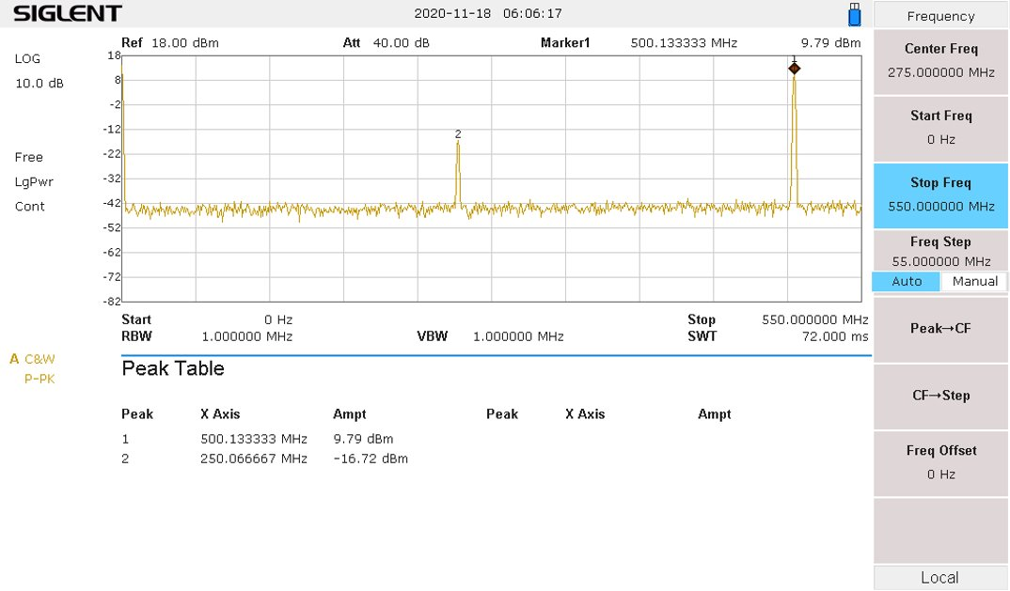
Subsystem 3: Validation Results – Frequency Range

Slide 22
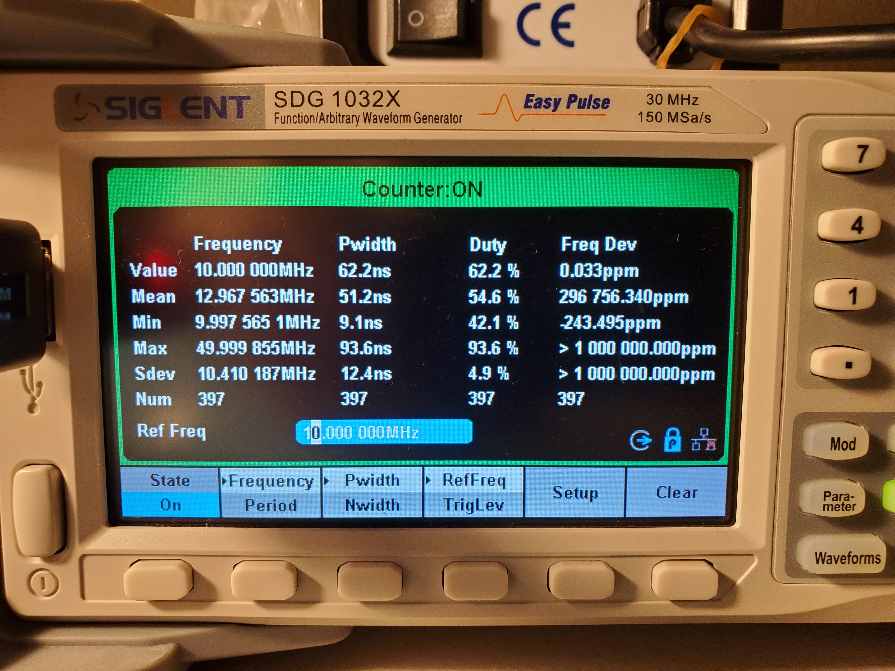
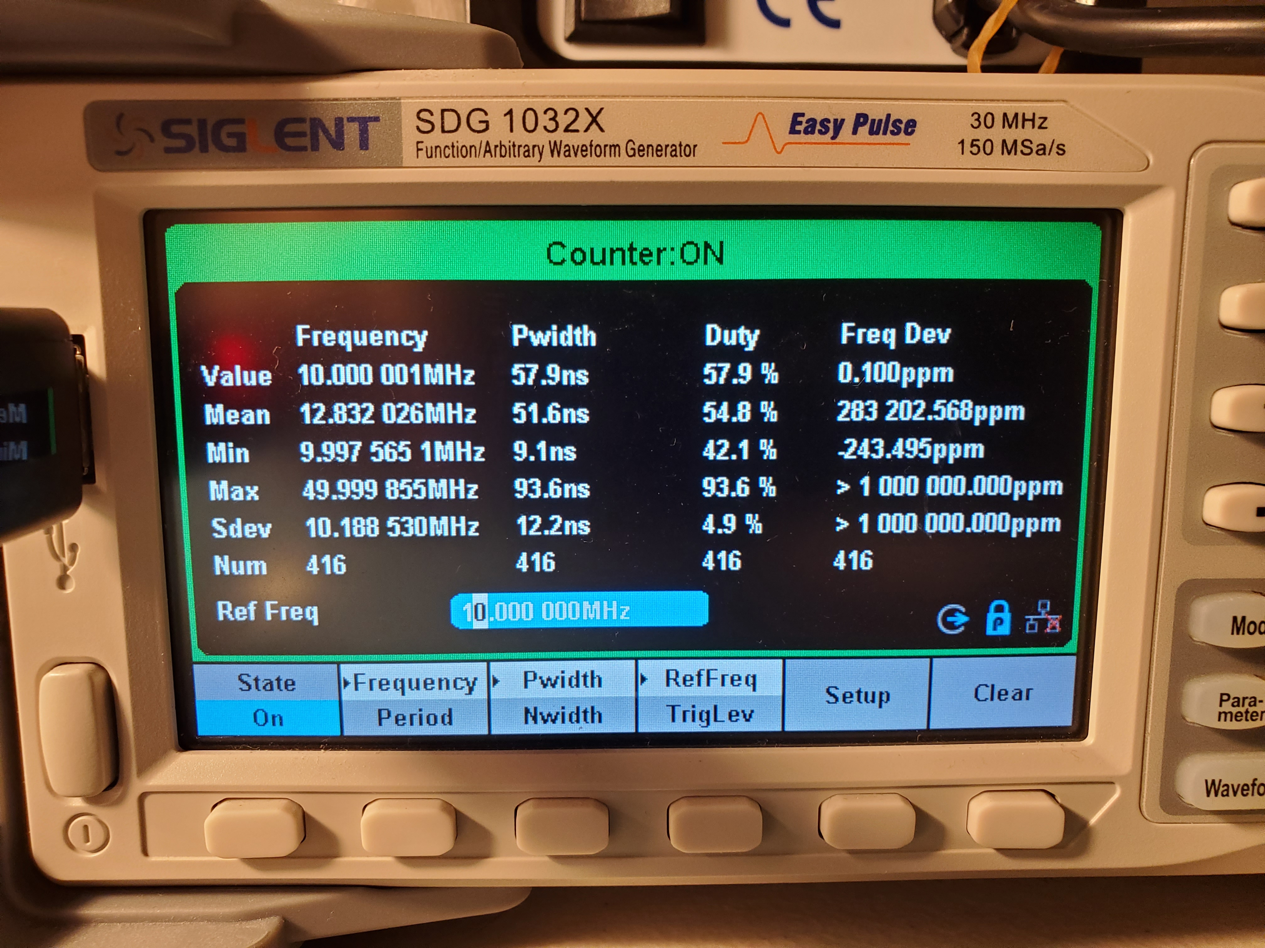
Subsystem 3: Validation Results - Precision
Synthesizer set to "10MHz"
Synthesizer set to "10.000001MHz"
Calibrated at 10MHz. Precision does not hold without proper calibration.

Slide 23
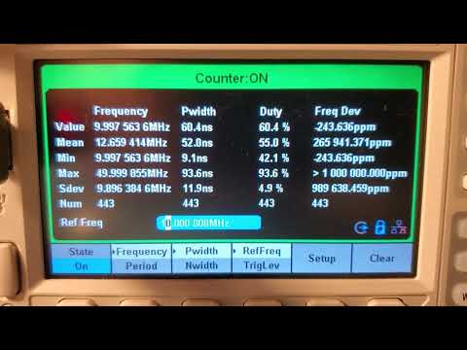
Subsystem 3: Validation Results - Precision

Slide 24
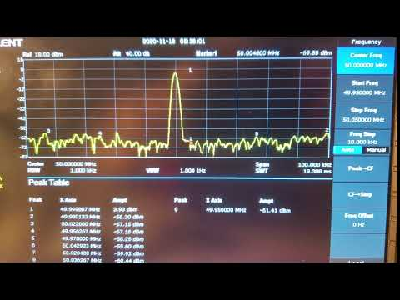
Subsystem 3: Validation Results - FM

Slide 25
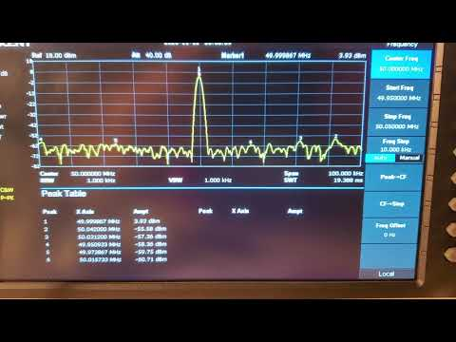
Subsystem 3: Validation Results - AM

Slide 26
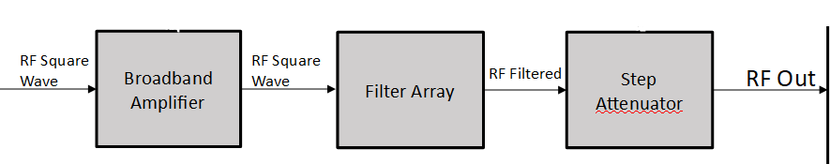
Subsystem 4: Broadband Amplifier/Filter Array/Step Attenuator
Amplifier increases the power of the carrier/modulated signal
Filters remove unwanted harmonics from square wave signal to produce a sinusoidal carrier
Attenuators reduce signal power to the user defined output power
Notes:
James

Slide 27
Subsystem 4: Deliverables
1 PCB with amplifier
3 PCBs containing a total of 9 Chebyshev filters
1 PCB with attenuation range from 1-100dB
Notes:
James

Slide 28
Subsystem 4: Challenges
Accounting for frequency response in components
Learning curve for PCB design
Notes:
James

Slide 29
Subsystem 4: Validation
Amplifier and filter PCBs are being fabricated
Finalizing layout for attenuator PCB
Notes:
James

Slide 30
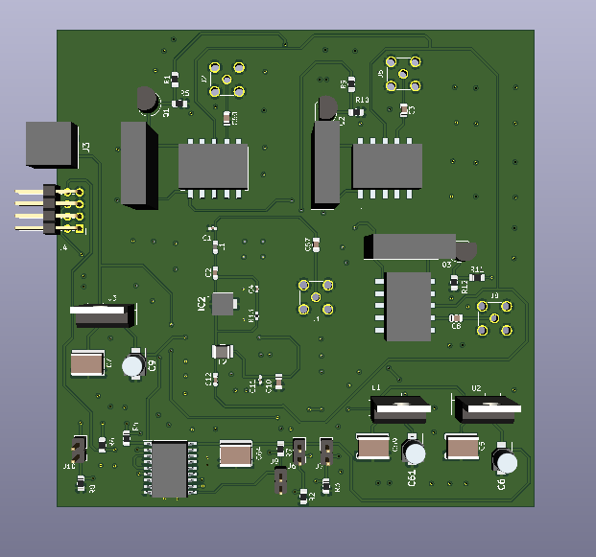
Subsystem 4: Amplifier 3D Model
3D Model generated in KiCad
Notes:
James

Slide 31
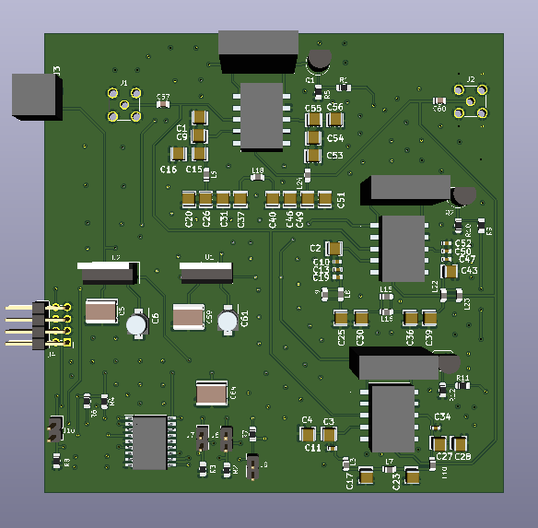
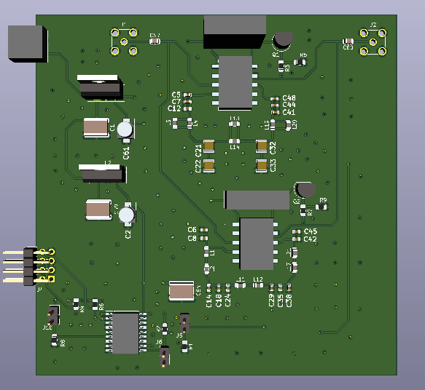
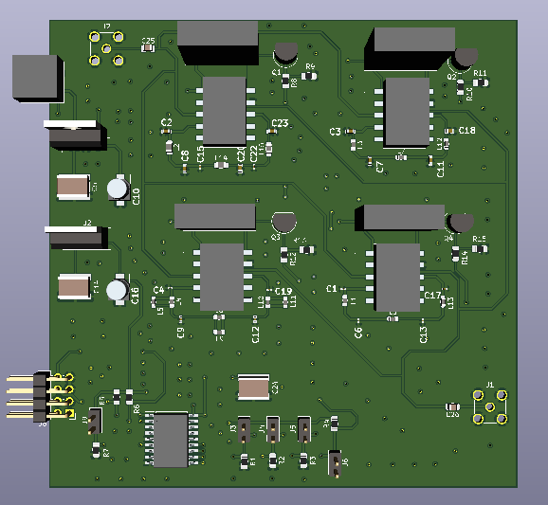
Subsystem 4: Filter 3D Models
3D Models generated in KiCad
Notes:
James

Slide 32
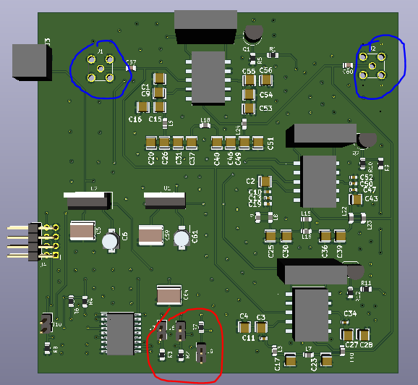
Subsystem 4: Validation
3D Model generated in KiCad
Notes:
James

Slide 33
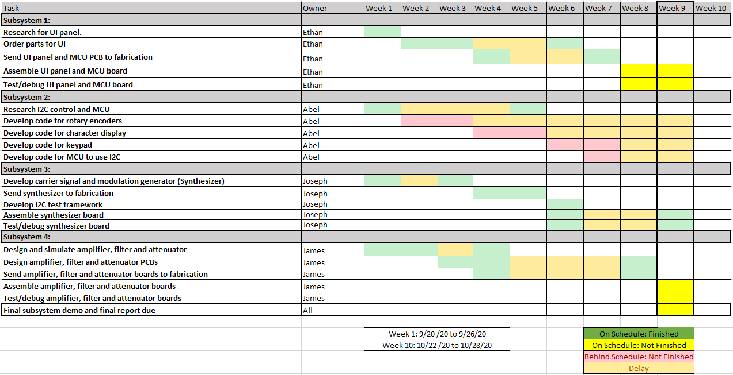
Execution and Validation

Slide 34
ECEN 404 Goals
Subsystem 1:
Integration with MCU
Case design to integrate all subsystems into 1 package
Subsystem 2:
Integrating other Subsystems
Frequency dependent calibration of output frequency and power
Subsystem 3:
Fix design errors/inadequacies found in original PCB design.
Add analog FM and ASK with greater than 2 states.
Subsystem 4:
Finish attenuator board
Fix errors discovered in testing for amplifier and filter boards

Slide 35
Questions

Slide 36
Thank You

